Slide 1


Model
bert-base-chinese

Slide 2

Model
derived from bert base uncased
trained on Chinese Wikipedia
treat each Chinese character as a single token
MLM
12 encoder layer
110M parameters

Slide 3
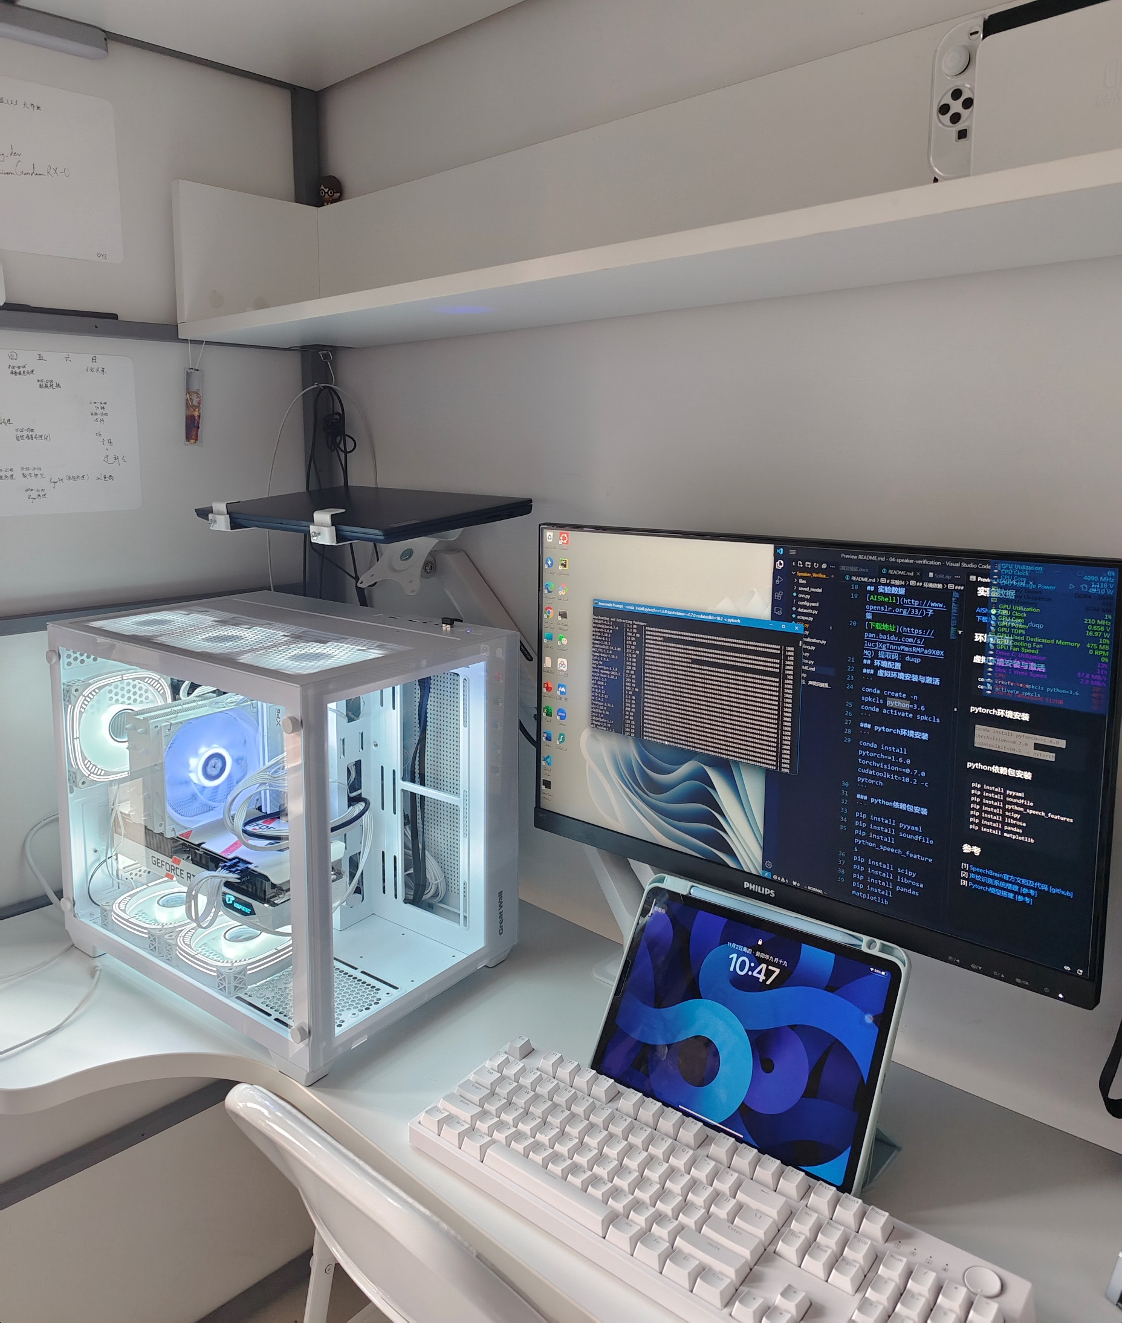
Training Setup
CPU: Intel Core i5-13400F
GPU: Nvidia Geforce RTX 3060
(12GB GRAM)

Slide 4
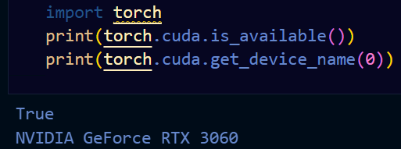
Training Setup
Python3.11
Pytorch2.1
Pytorch-Cuda 12.1
Transformers 4.32.1

Slide 5

Data Preprocessing

Slide 6
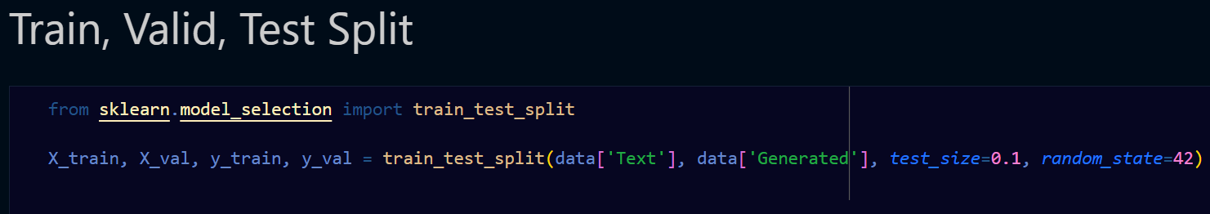
Data Preprocessing
Train 70%
Valid 10% (monitoring performance on unseen data during training)
Test 20%

Slide 7
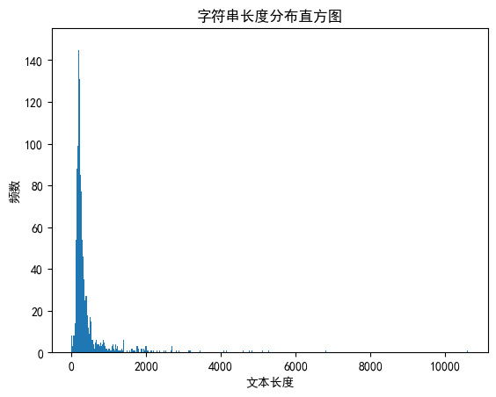
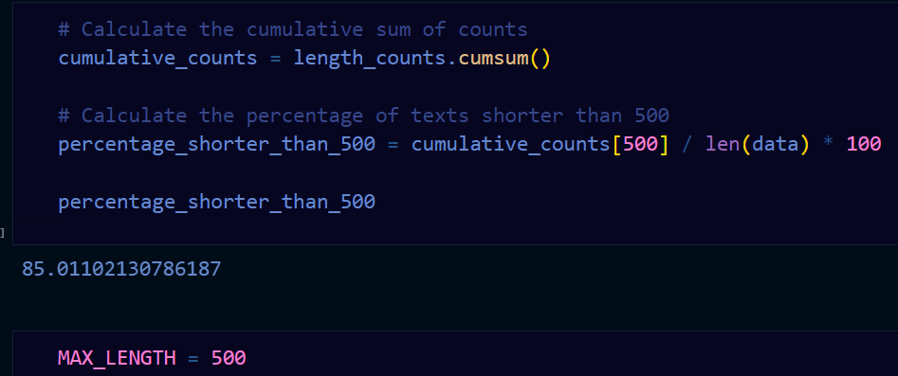
Max Length
Setting lower max_length to decrease the training time

Slide 8
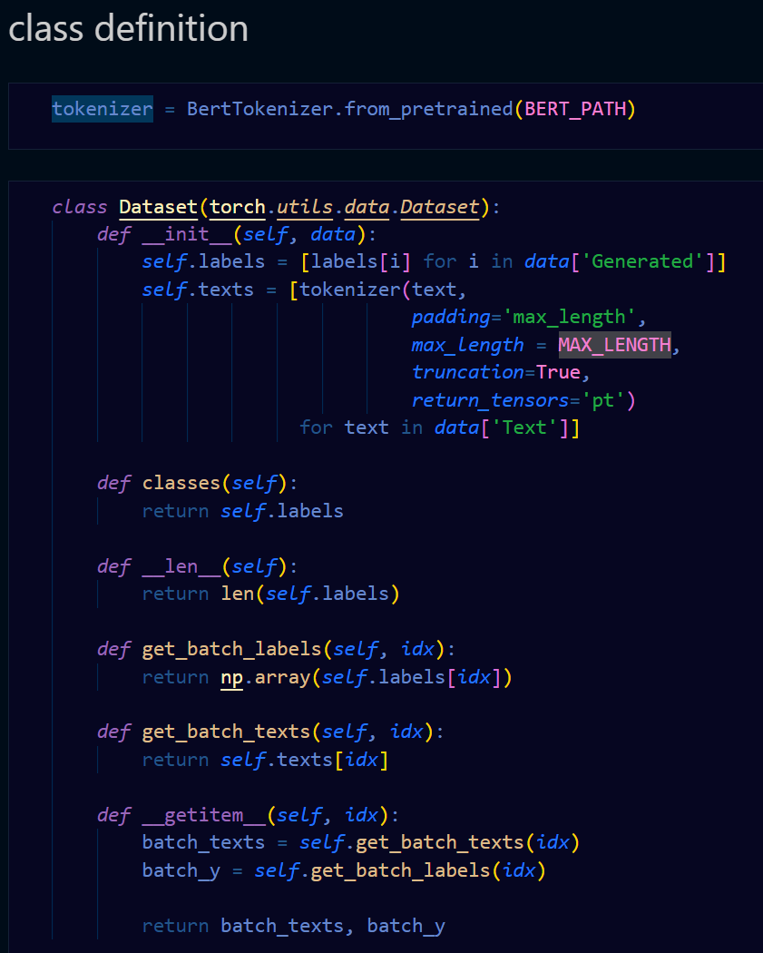
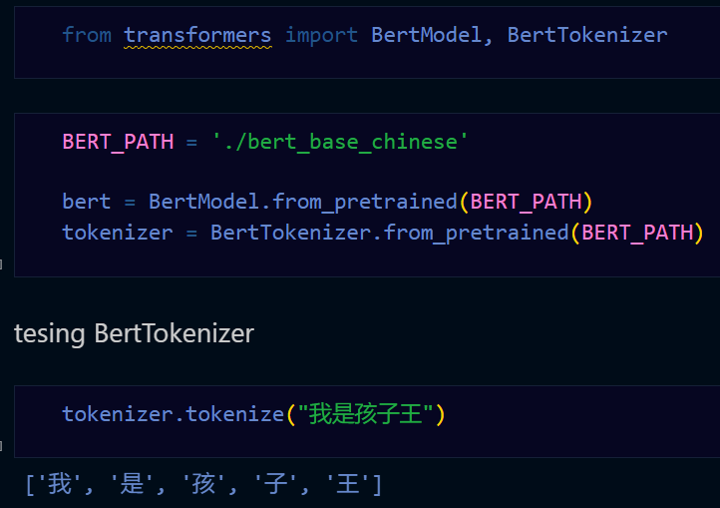
Tokenizer

Slide 9
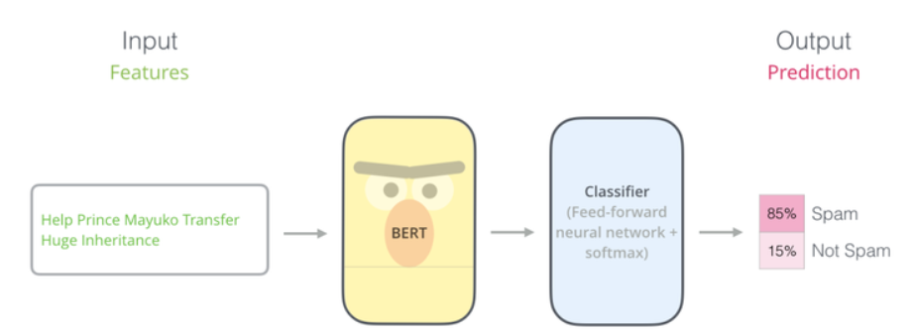
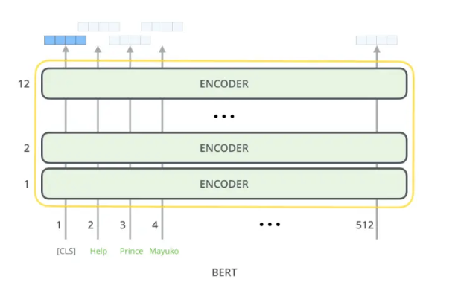
Model Architecture
vector (768 dims)
12 encoder layer
maximum length of sequence: 512

Slide 10
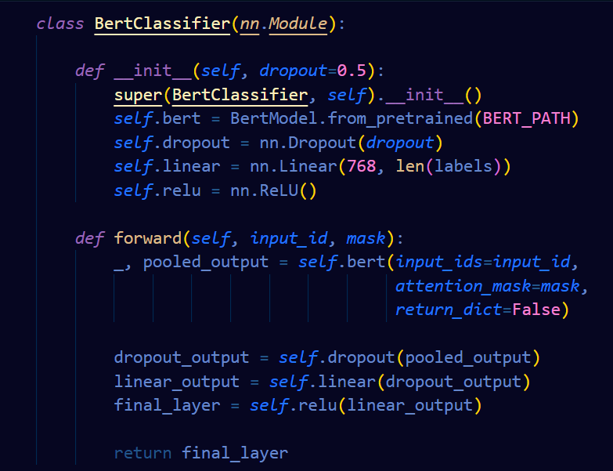
Model Architecture
transformer
binary classification, two labels
activation layer

Slide 11
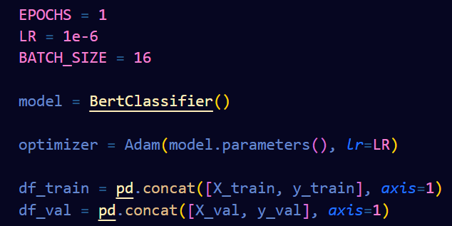
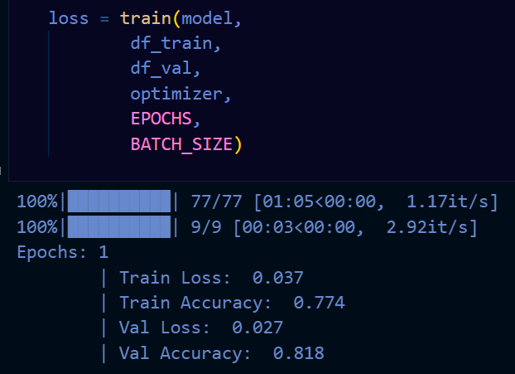
Parameters Setup
11 epoch in total
occupied full
12GB GRAM

Slide 12
Monitoring Training Status
100%|██████████| 153/153 [01:11<00:00, 2.13it/s]100%|██████████| 18/18 [00:02<00:00, 6.60it/s]Epochs: 1 | Train Loss: 0.039 | Train Accuracy: 0.868 | Val Loss: 0.027 | Val Accuracy: 0.949100%|██████████| 153/153 [01:11<00:00, 2.13it/s]100%|██████████| 18/18 [00:02<00:00, 6.61it/s]Epochs: 1 | Train Loss: 0.026 | Train Accuracy: 0.924 | Val Loss: 0.021 | Val Accuracy: 0.942100%|██████████| 153/153 [01:11<00:00, 2.13it/s]100%|██████████| 18/18 [00:02<00:00, 6.58it/s]Epochs: 1 | Train Loss: 0.017 | Train Accuracy: 0.957 | Val Loss: 0.014 | Val Accuracy: 0.964100%|██████████| 153/153 [01:12<00:00, 2.12it/s]100%|██████████| 18/18 [00:02<00:00, 6.56it/s]Epochs: 1 | Train Loss: 0.011 | Train Accuracy: 0.975 | Val Loss: 0.009 | Val Accuracy: 0.985100%|██████████| 153/153 [01:12<00:00, 2.12it/s]100%|██████████| 18/18 [00:02<00:00, 6.58it/s]Epochs: 1 | Train Loss: 0.008 | Train Accuracy: 0.989 | Val Loss: 0.008 | Val Accuracy: 0.978100%|██████████| 153/153 [01:12<00:00, 2.12it/s]100%|██████████| 18/18 [00:02<00:00, 6.59it/s]Epochs: 1 | Train Loss: 0.006 | Train Accuracy: 0.994 | Val Loss: 0.007 | Val Accuracy: 0.985100%|██████████| 153/153 [01:12<00:00, 2.11it/s]100%|██████████| 18/18 [00:02<00:00, 6.62it/s]Epochs: 1 | Train Loss: 0.004 | Train Accuracy: 0.997 | Val Loss: 0.004 | Val Accuracy: 1.000100%|██████████| 153/153 [01:12<00:00, 2.11it/s]100%|██████████| 18/18 [00:02<00:00, 6.62it/s]Epochs: 1 | Train Loss: 0.003 | Train Accuracy: 0.997 | Val Loss: 0.004 | Val Accuracy: 0.985100%|██████████| 153/153 [01:12<00:00, 2.12it/s]100%|██████████| 18/18 [00:02<00:00, 6.56it/s]Epochs: 1 | Train Loss: 0.003 | Train Accuracy: 0.998 | Val Loss: 0.005 | Val Accuracy: 0.985100%|██████████| 153/153 [01:12<00:00, 2.11it/s]100%|██████████| 18/18 [00:02<00:00, 6.60it/s]Epochs: 1 | Train Loss: 0.002 | Train Accuracy: 0.999 | Val Loss: 0.004 | Val Accuracy: 0.993

Slide 13
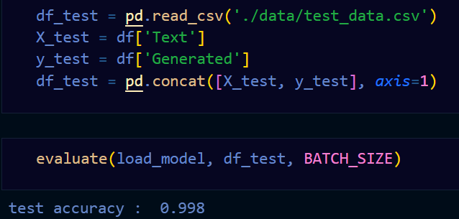
Evaluation

